Slide 1
Initiative - Referendum AMCA Elections Training 2019
Stacy Saltzburg, MMC Elizabeth A. Burke, MMC
City Clerk Town Clerk
City of Flagstaff Town of Fountain Hills
Notes:
LB
My name is Liz Burke and I am the Town Clerk for Fountain Hills. Along with me is Stacy Saltzburg, City Clerk from Flagstaff, who was the best deputy I could have ever asked for!
When we were each asked to present, we decided to combine the two types of elections because they are very similar in many aspects.
Today we hope to provide some insight, some tips, and some understanding to the initiative/referendum process. We welcome any and all questions, comments, corrections, or other ways you might do these things.
Feel free to stop us at any time.

Slide 2
Outline
What is an Initiative?
What is a Referendum?
Authority
Initiative / Referendum Packet
Signature Requirements
Timing Requirements
Requirements for Petition Circulation
Petition Submittal Process
Petition Review Process
Random Sample Process
Final Certification
Notes:
LB
We will be reviewing the following things:
What an initiative is
What a referendum is
The authority for both of these
What is in an Initiative/Referendum Packet
Signature Requirements
Timing Requirements
Petition Circulation Requirements
Petition Submittal Process
Petition Review Process
The Random Sample Process
Final Certification

Slide 3
WHAT IS AN INITIATIVE? … A REFERENDUM?
INITIATIVE:
A new law or ordinance is INITIATED by electors
REFERENDUM:
An ordinance adopted by the Council is REFERRED to the electors
Notes:
LB
An initiative is a new law or ordinance that is INITIATED by the electors
A referendum is an ordinance adopted by the Council, but referred to the electors for the final decision

Slide 4
The process is governed by:
the state constitution, article iv
And
Arizona revised statutes, title 19
Notes:
LB
The Initiative and Referendum process is governed by the State Constitution and Title 19 of the Arizona Revised Statutes. We highly recommend that you get familiar with these and stay familiar with them.

Slide 5
Arizona Constitution Article IV, Part 1, SECTION 1 (8)
(8) Local, city, town or county matters.
The powers of the initiative and the referendum are hereby further reserved to the qualified electors of every incorporated city, town, and county...Under the power of the initiative fifteen per centum of the qualified electors may propose measures on such local, city, town, or county matters, and ten per centum of the electors may propose the referendum on legislation enacted within and by such city, town, or county….
Notes:
LB
Power of the initiative – 15% of the qualified…
10% may propose the referendum on legislation
Both of these read …%of the qualified electors….

Slide 6
Arizona revised statutes §19-143 (a) - iNITIATIVE
19-143. Initiative petition in cities; action of council; amendment of charter
The whole number of votes cast at the city or town election at which a mayor or councilman was chosen last preceding the submission of the application for an initiative petition is the basis for computing the number of qualified electors of the city or town required to sign the petition unless the city or town by charter or ordinance provides an alternative basis for computing the number of necessary signatures.
Notes:
LB
As we see in ARS 19-143A, the 15% is further described as the whole number of votes cast…

Slide 7
Arizona revised statutes §19-142 (a) - referendum
19-142. Referendum petitions against municipal actions; emergency measures; zoning
actions
The whole number of votes cast at the citywide or townwide election at which a
mayor or councilmen were chosen last preceding the submission of the application
for a referendum petition against an ordinance, franchise or resolution shall be the
basis on which the number of electors of the city or town required to file a
referendum petition shall be computed. For the purposes of this section, a citywide
or townwide election is an election at which all of the qualified electors of a city or
town are eligible to vote for a mayor or members of the city or town council. The
petition shall be filed with the city or town clerk within thirty days after passage of
the ordinance, resolution or franchise.
Notes:
LB
And under ARS 19-142A it also reads
…whole number of votes cast….

Slide 8
TIMING REQUIREMENTS
INITIATIVE – ARS 19-121(D)
…. in no event shall the secretary of state (clerk) accept an initiative petition that was issued for circulation more than twenty-four months before the general election at which the measure is to be included on the ballot.
REFERENDUM – ARS 19-142(A)
…the petition shall be filed with the city or town clerk within thirty days after passage of the ordinance, resolution or franchise.
Notes:
LB

Slide 9
Signature REQUIREMENTS
EXAMPLE: In the 08/28/2018 election there were 8,561 ballots cast
Initiative – 15% 8,561 x 15% = 1,284.15 OR 1,285 REQUIRED
Referendum – 10% 8,561 x 10% = 856.1 OR 857 REQUIRED
U N L E S S you are a charter city/town and it dictates differently OR you have
adopted an ordinance allowing for a different method of determining the numbers
Notes:
LB

Slide 10
Initiative / REFERENDUM Packet
Recap of Forms/Signature Requirements
Memo for Applicants of Initiative / Referendum Serial Number
Application for Initiative / Referendum Serial Number
Initiative OR Referendum Petition (English and Spanish)
Initiative, Referendum and Recall Handbook (SOS)
Political Action Committee Statement of Organization (SOS)
Campaign Finance Handbook (SOS)
Campaign Finance Report Forms (SOS)
Political Action Committee Termination Statement (SOS)
Notes:
LB
The first step in the process begins before there is even a petition to speak of. Compiling an Initiative/Referendum Packet. I usually keep 2 or 3 of these on hand because you never know when someone might want to start the process. While I try to encourage people to schedule an appointment with me to review the packet most times they just show up (often at the most inconvenient time) and having the packet ready is so helpful and avoids a lot of awkward scrambling.
Included in the packet are the following items:
Recap of Forms & Signature Requirements – this is a document that recaps the forms in the packet (kind of like a table of contents) and the signature requirements.
Memo for Applicants of Initiative/Referendum Serial Number – this is a simple document that reminds applicants that they must file a statement of organization if they have not already done so.
Application for Initiative/Referendum Serial Number – this application is where the applicant provides a summary of the proposed initiative in 100 words or less. They also provide pertinent information regarding the applicant and/or organization.
I include one copy of each petition in the packet for their reference.
I also include the Initiative, Referendum and Recall Handbook provided by the SOS.
There is a Political Action Committee Statement of Organization and a copy of the Campaign Finance Handbook and a set of Campaign Finance Report Forms.
Lastly, I provide a Political Action Committee Termination Statement.
With the exception of the campaign finance handbook (accessible on the SOS website) all of these documents can be found linked in the Election Manual that is put out by the League.

Slide 11
The clerk’s role in an initiative or referendum
The Clerk is the filing officer for the city/town and:
Receives a completed Application for Serial Number from an applicant ALONG WITH a Statement of Organization for an Initiative or Referendum
Assigns the petition serial number for an Initiative or Referendum
Receives and reviews initiative/referendum petitions for completeness and qualification
Works with County on signature verification
If successful, prepares ballot wording and Information Packet for election
Receives arguments for / against question on ballot
Notes:
LB

Slide 12
To circulate INITIATIVE/REFERENDUM petitions one must…
Submit an application for initiative/referendum serial number
Clerk assigns number (Example: IN2019-001 OR REF2019-001)
Provide a description of the principle provisions – not more than 100 words.
Provide the full and correct copy of the title and text of the measure (must be attached to all petitions). (Clerk to date/time stamp each page or title/text and that copy must be attached to petitions).
Submit a Political Action Committee Statement of Organization.
Register circulators that are not AZ residents with the Secretary of State.
Notes:
LB
In order to begin circulating petitions the applicant must first submit an application for an initiative serial number which is assigned by the clerk. They must also provide a description of the principle provisions of the measure as well as the full and correct copy of the title and text of the measure. They must submit a Political Action Committee Statement of Organization and they also must register any petition circulators that are not Arizona residents with the SOS.
At this time I notify the TM, TA, and TC that an application has been received for an initiative/referendum measure.

Slide 13
DISCLAIMER
The next few slides lay out the process that the City of Flagstaff uses.
Your city/town may use a slightly different process.
ALWAYS consult with your attorney.
Notes:
SS
Over the next few slides I am going to review the signature review process that we use in Flagstaff. It is possible that your city/town may do things slightly different. As always, consult with your attorney if you have any questions or concerns about the process.
As I said earlier, I am not an expert so if you do something different please share, there may be better ways to do things.

Slide 14
Receipt of Initiative / REFERENDUM Petitions
If possible, schedule an appointment to receive the petitions.
Initial Receipt – estimate of the number of sheets and signatures filed.
**This does NOT indicate that the measure has qualified for the ballot**
No additional petitions may be filed and the petitions or individual signatures cannot be withdrawn.
Notify City Manager, City Attorney, City Council, County Recorder, etc.
Notes:
SS
I always try to schedule an appointment with the applicant. This helps me make sure I have time to prepare and have all my forms ready as well as have enough time set aside to process the initial receipt.
Once the petitions have been turned over to the Clerk you issue an initial receipt. This receipt essentially estimates how many sheets and signatures are being submitted. This in no way indicates that a measure has qualified for the ballot.
Again I notify the CM, CA, CC, and also the County Recorder that petitions have been submitted to our office.

Slide 15
Initial Receipt
Remove the copy of the title and text from the petition sheets, separating any sheets that the text is not attached to.
Write the number of signatures in the lower right hand corner of petition (I do not include any more than 15 signatures).
Separate petitions based on the number of signatures.
Record the number of sheets for each set on the tally sheet.
Calculate the estimated number of signatures.
Issue Initial Receipt.
Notes:
SS
Once petitions are handed over to the Clerk, an initial receipt is issued. In Flagstaff we remove the copy of the title/text from the petition sheets at this time. If we come across a sheet that does not have the required attachment we set it aside.
Once those are removed we document the number of signatures on each sheet in the lower right hand corner. I do not count any more than 15 signatures.
I then sort the sheets based on the number of signatures. I record the number of sheets for each set on the tally sheet and calculate the estimated number of signatures.
With this information I complete and issue the initial receipt.

Slide 16
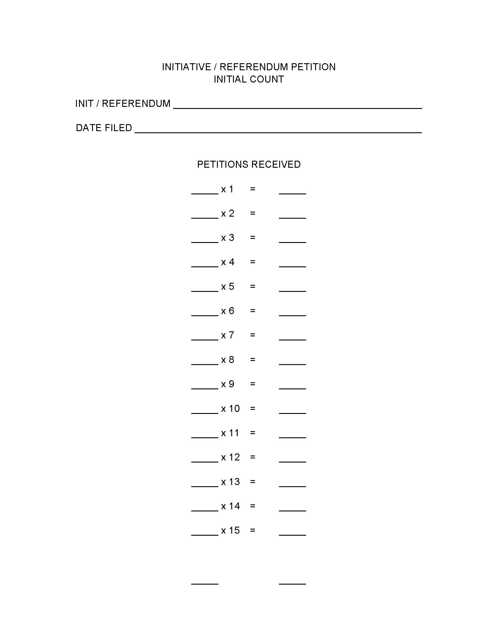
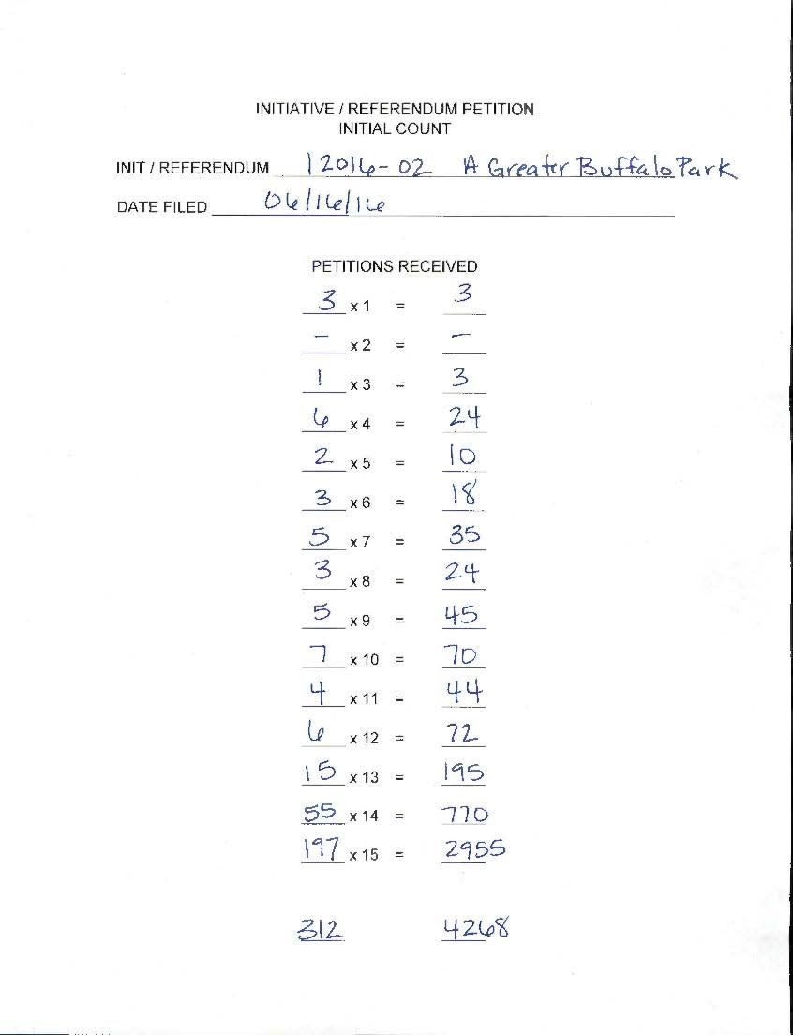
Notes:
SS
This is an example of the tally sheet we use in Flagstaff. This tally form makes it easy for us to calculate the number of signatures.

Slide 17
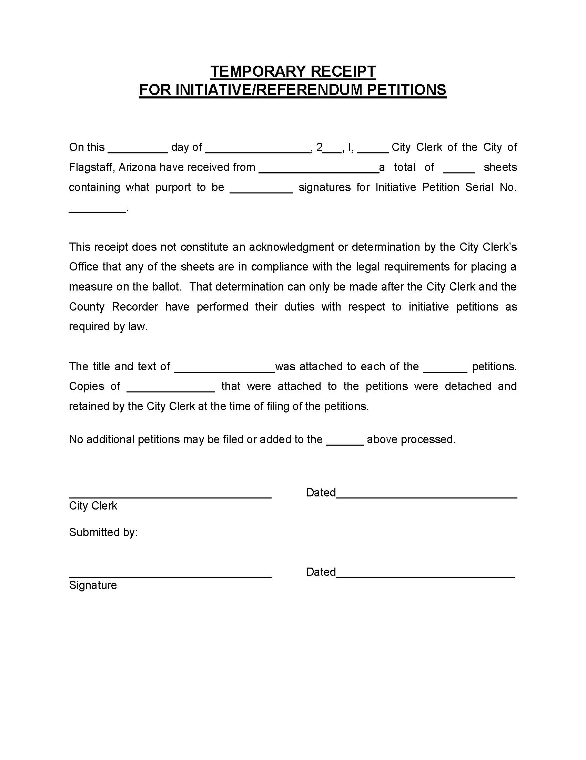
Notes:
SS
And here is the Temporary Receipt that we issue. You will see that it shows the number of sheets and the number of signatures. Additionally, it notes that the title and text were attached, removed and retained by the Clerk.

Slide 18
TIPS for PETITION Review 20 days, excluding weekends and holidays
Be Prepared!
Have the Election Manual, statutes, tally sheets and other materials ready and available.
Conduct your review somewhere quiet and with no interruptions.
Go step by step.
It takes more time but TRUST ME, when you try to do too many steps at one time mistakes are made and you have to go back and re-do the process…NOT FUN!
Keep track of what you have removed and why.
This will help tremendously when you issue a final receipt/certification.
Notes:
SS
As we go into the review portion of petitions and the removal of sheets and signatures, I want to provide you with a couple of tips that I have.
First, be prepared! Have all of your statutes, tally sheets, forms and materials ready and available. Despite our best efforts to schedule appointments, people can and will show up at any time to turn in petitions. When you know petitions are being circulated it is a good idea to have all your stuff ready to go in case they show up unannounced.
Second, go step by step. I learned this one the hard way, one of the initiatives we did this last year had to be reviewed 4 different times because the numbers were not adding up. Part of this was because we were rushed in our timeline and because we were rushed we tried to do too many things at one time during our review. It was not worth it in the end. Take your time and do only 1 step at a time.
Lastly, keep track of the sheets and signatures you have removed and why. Again, I learned this the hard way. I went through everything and when I went to issue my certification receipt I realized I needed to account for why things had been removed. This meant that I had to go back through everything and tally up why I did what I did. I can tell you that it is not always so clear why you removed something 2 days after you removed it. I use lots of sticky notes!

Slide 19
PETITION Review SHEET REMOVAL
SHEET Removal
ARS § 19-121.01(1)
The Clerk must REMOVE the following:
Those sheets not attached to a copy of the complete title and text of the measure (Flagstaff does this with the temporary receipt process).
The copy of the title and text from the remaining petition sheets (Flagstaff does this with the temporary receipt process).
Those sheets not bearing the correct petition serial number in the lower right-hand corner of each side.
Notes:
SS
OK, now for the Petition Review. For me, this was the most scary thing. What if I missed one, what if I missed a lot, what if I removed something I was not supposed to? The good thing is, the steps are laid out one by one and with the help of my City Clerk and attorney clarifying some of the steps I was able to get through it. Take your time and don’t be afraid to ask for assistance.
The review process is split into two sections - sheet removal first, then signature removal.
REVIEW THE SLIDE
As mentioned earlier, a serial number is assigned when the political action committee applies for an initiative/referendum serial number, this number must be in the lower right corner on the front and back of every petition.

Slide 20
PETITION REVIEW SHEET REMOVAL (Cont.)
Those sheets containing a circulator's affidavit that is not completed or signed or that has been modified.
Those sheets on which the affidavit of the circulator is not notarized, the notary's signature is missing, the notary's commission has expired or the notary's seal is not affixed.
Those sheets on which the signatures of the circulator or the notary are dated earlier than the dates on which the electors signed the face of the petition sheet.
Those sheets on which the circulator of the petition has not stated whether he is a paid or volunteer circulator in accordance with A.R.S. § 19-101 and § 19-102.
Notes:
SS
REVIEW THE SLIDE

Slide 21
PETITION REVIEW SHEET REMOVAL (Cont.)
Those sheets circulated by a circulator who has been convicted of petition signature fraud under A.R.S. § 19-119.01.
Those sheets on which the circulator is required to be registered with the Secretary of State pursuant to A.R.S. § 19-118 and the circulator is not properly registered at the time the petitions were circulated.
https://www.azsos.gov/elections/requirements-paid-non-resident-circulators
Notes:
SS
REVIEW THE SLIDE
Petition circulators who are not residents of Arizona must register with the Secretary of State’s Office BEFORE circulating petitions.
The SOS’s website posts the circulators registered for each election cycle. They also include a section that lists persons convicted of Petition Signature fraud.
Set the removed sheets aside and make note of the number of sheets removed.

Slide 22
PETITION Review signature removal
SIGNATURE Removal
ARS § 19-121.01(3)
Remove the following signatures by placing an adjacent mark or striking through the signature line (I have continued to use the red SS in the right margin):
If the signature of the qualified elector is missing.
If the residence address or the description of residence location is missing.
Notes:
SS
Once the invalid sheets are removed we move to signature removal. The signatures are removed by placing a mark next to or through the signature line. Personally, I have continued to use the SS in red ink in the right margin. For me it is easier to see as I am sorting through the petitions.
Again, don’t forget to document why you are removing things!
REVIEW SLIDE

Slide 23
PETITION Review Signature Removal (cont.)
If the date on which the petitioner signed is missing or,
If the date the petitioner signed is before the date that the Statement of Organization was filed for the political committee which is filing the petition
If the date on which the petitioner signed is after the date on which the affidavit was completed by the circulator and notarized.
4. Signatures in excess of the fifteen signatures permitted per petition.
5. Signatures withdrawn pursuant to A.R.S. § 19-113.
6. Signatures for which the clerk determines that the petition circulator has printed the elector's first and last names or other information in violation of A.R.S. § 19-112.
Notes:
SS
REVIEW SLIDE
#6 – this one is the most difficult of the removals because it is purely a judgment call. In these instances we make sure that at least two of us review the information and agree on the conclusion.

Slide 24
AFTER REMOVAL OF SHEETS AND SIGNATURES
Count the number of signatures for verification on the remaining petitions sheets and note the number in the upper right-hand corner of the petition.
Sort the petitions based on the number of signatures.
Record the number of sheets for each set on the tally sheet.
Calculate the number of signatures remaining.
Number the remaining petition sheets in consecutive order on the upper left-hand corner of the petition.
Notes:
SS You have gone through all the petitions and removed qualifying sheets and signatures, now you calculate the remaining signatures to find out if there are enough signatures to move onto the next step.
We repeat the process of noting the number of signatures but now it is on the upper right hand corner. We sort the sheets based on the number of signatures and record the number of sheets for each set on the tally sheet. Then calculate the remaining signatures.
At this point I will check my numbers against my original tally to make sure the number of sheets originally submitted minus the sheets removed through the process equals the number of sheets remaining. I also do this with the signatures.
Should there not be enough signatures the process stops here. You would issue a receipt to the applicant notifying them that the number of signatures is not sufficient and return the original petitions. We will review the form of the receipt in just a moment. You would just modify it to reflect that there were not enough signatures to qualify.
If there are enough signatures, consecutively number the remaining sheets in the upper left corner and move on to the next steps.

Slide 25
AFTER REMOVAL OF SHEETS AND SIGNATURES (Cont.)
If the total number of signatures equals or exceeds the minimum requirement, select, at random, 5% of the total signatures for verification by the County Recorder.
The Secretary of State’s office has a program which can be used to make the random sample.
Send an email to the Secretary of State’s office stating number of petitions and number of signatures.
Issue a receipt to the applicant of the total number eligible for verification.
Notes:
SS You will then identify a 5% random sample to send to the County for verification. The Secretary of State’s office has a program that will calculate the random sample for you. You provide them with the total number of valid sheets and the total number of valid signatures. They plug it into their system and it spits out the random sample.
A receipt is then issued to the applicant that indicates the number of sheets and signatures initially received, a breakdown of how many sheets and signatures were removed**, and the total number of signatures remaining. **While I don’t think this breakdown is required, you know they are going to ask why they were removed**
If there were enough signatures then you should include the number of signatures contained in the 5% sample that are being forwarded to the County for verification. Flagstaff includes all this information on one receipt and we also have the County sign off that they are receiving the indicated number of petitions/signatures.

Slide 26
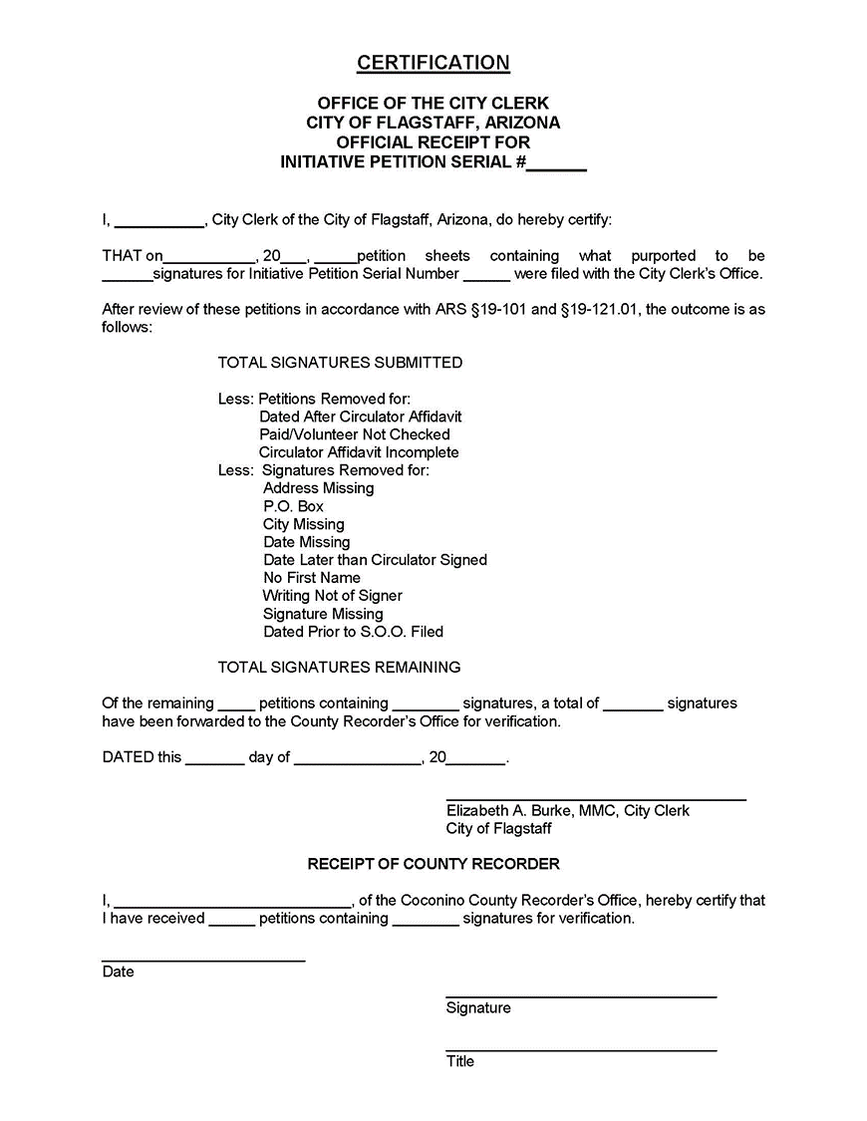
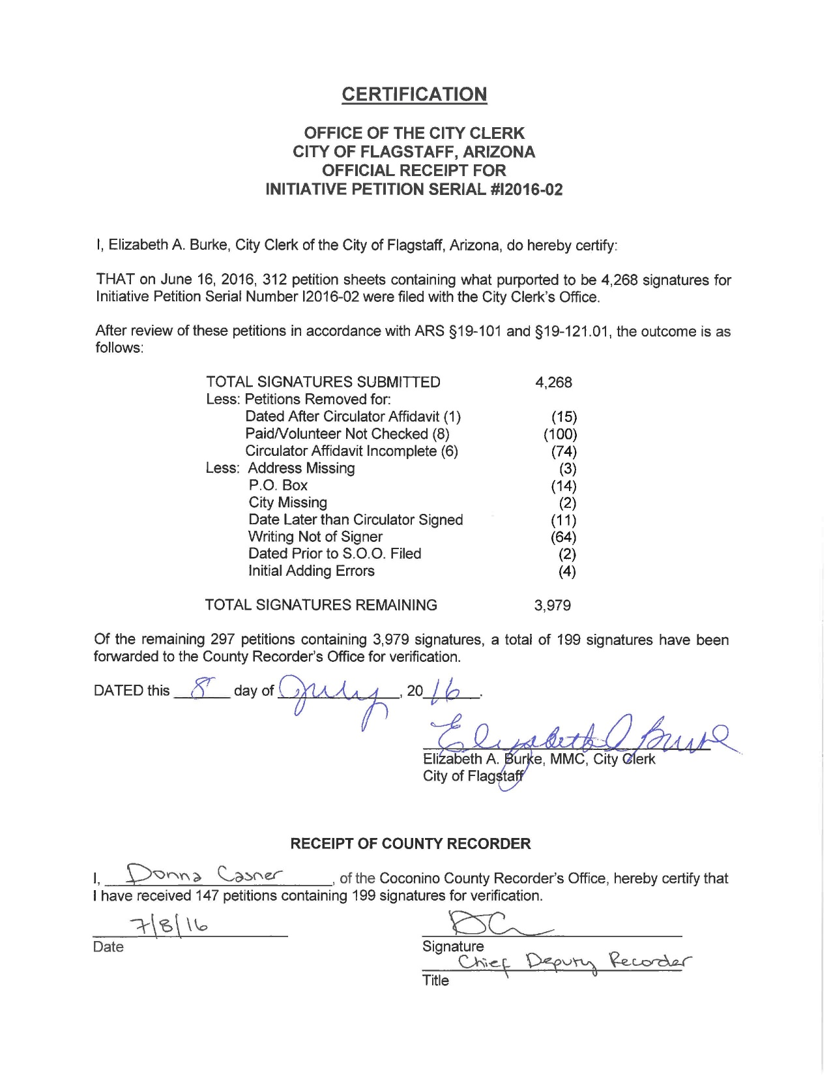
Notes:
SS
This is the receipt that Flagstaff uses for their initiative/referendum petitions. I have included a completed one to show how we break down the sheets and signatures removed.

Slide 27
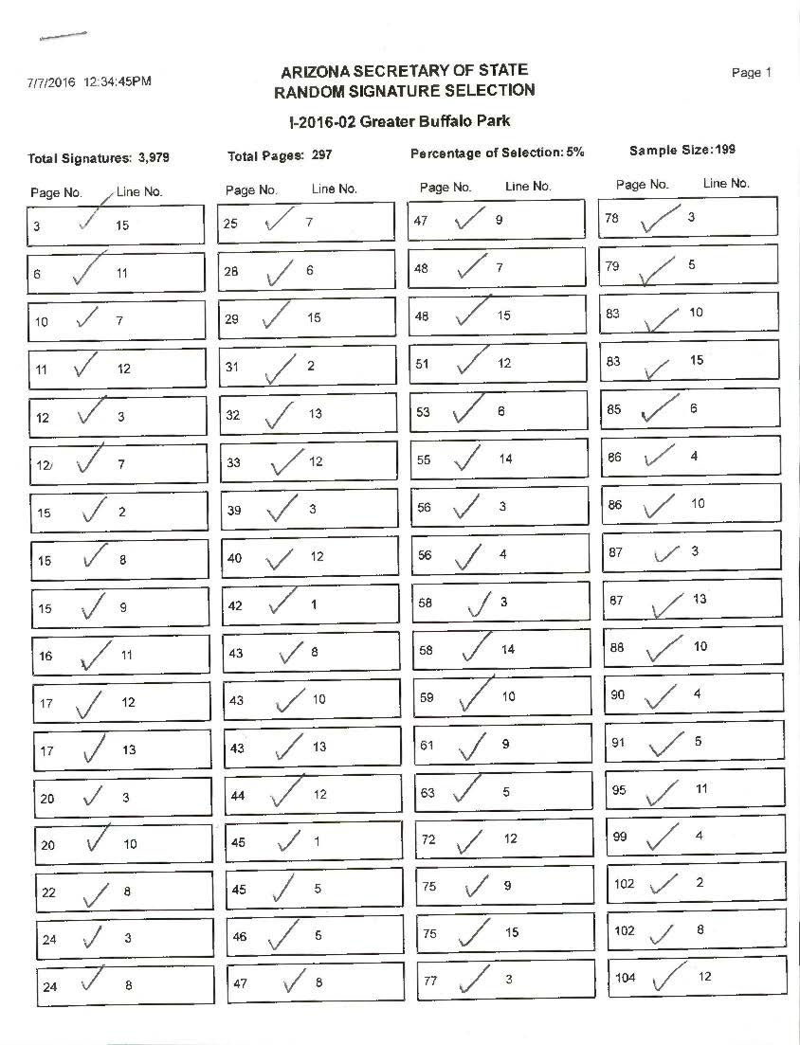
Notes:
SS
This is what the Random Sample looks like from the SOS. The report identifies the sheet number (this is why you number the sheets consecutively) and the signature line number for each signature in the sample.

Slide 28
Random Sample
Mark the selected signature in a clear manner (I still circle the line number and draw a line from the base of the circle extending into the left margin).
If a signature line is found to be blank or marked with an SS then:
Go to the next line down (even if that means going to next sheet) on which an eligible signature appears.
If that line is already being used in the random sample then:
Proceed back up the page from the originally selected signature to the next previous signature.
If that line is already being used in the random sample then:
Proceed down the page (or to the next page) to the next eligible signature.
Notes:
SS
You can now mark the signatures identified in the random sample. I still circle the line number and draw a line from the base of the circle extending into the left margin. This process can be a little tricky so it is HIGHLY recommended that you have the statutes / election manual there with you to guide the way.
Because we sort the petition sheets by number of signatures to calculate the signature count the first sheets in the stack usually only have a few signatures on them. This means we are using this process heavily at the beginning due to blank signature lines. We also run into this process when the random sample identifies lines that have been removed through the review process.
REVIEW SLIDE
Again, take your time here and go step by step. If you end up marking a line that is different then what the random sample indicates (due to this process) make a note of it on the random sample sheet. I simply cross out the page and line number and replace it with the number I marked (this indicates to me that I used this process to identify another signature and my result is documented).
As you identify the signatures place the marked sheets in a separate pile (some choose to do this after all have been marked)

Slide 29
Random Sample (cont.)
This process continues until an eligible signature is identified.
Once the marking of the random sample is complete make a copy of the front of each signature sheet that includes a random sample marking.
Using the copied sheets, highlight the random sample selections.
Transmit the copied/highlighted sheets to the County (Flagstaff hand delivers and makes the County verify and sign for the petitions).
The County has 15 days, excluding weekends and holidays to complete and return their certification.
If someone wishes to challenge the signatures certified they must do so by action in superior court within 5 calendar days of when the Recorder notifies the Clerk of the number of certified signatures.
Notes:
SS Once the marking is completed make a copy of the front of each petition sheet that includes a random sample marking.
Using the copies, highlight the random sample selections.
***Funny story*** remember how I said earlier trying to do too many things at one time caused me problems? Well with one petition we got to the random sample process, got our sample from the SOS and got ready. We made copies of all the petitions and started marking the random samples. We got to the end and realized that we should have marked the original petitions and then make copies of just those marked. Not only did we have to go back and mark the original petitions to match the markings on the copies but we had copies of the petition that we did not need.
Take your time folks and read the steps thoroughly.
Once you have made copies of the marked sheets go back through and with a highlighter highlight the line of each random sample selection.
You then transmit those highlighted sheets to the County. In Flagstaff we are lucky enough to have our County Recorder within walking distance so we hand deliver our petitions.
The County then has 15 days to complete their certification.
If someone wishes to challenge the number of signatures certified they must do so within 5 calendar days of when the Recorder notifies the Clerk of the number of certified signatures.

Slide 30
Final Certification/Receipt
Within 72 hours of receiving the County certification, excluding weekends and holidays, the Clerk will determine the total number of valid signatures by:
Determining the percentage of all signatures found to be invalid in the random sample and subtracting a like percentage from those signatures remaining.
If the number of valid signatures is equal to or exceeds the minimum required then a receipt is issued to the applicant with a copy of the County certification.
If the number of valid signatures is less than the minimum required then a receipt is issued to the applicant with a copy of the County certification and the original signature sheets are returned to the applicant after the time for challenging has passed.
Notes:
SS
Within 72 hours of receiving the County certification the Clerk will determine the total number of valid signatures by determining the percentage of all signatures found to be invalid in the random sample and applying that percentage to the signatures remaining.
If the number of signatures is sufficient then a final receipt is issued to the applicant with a copy of the County certification.
If the number of signatures is less than the minimum required then a final receipt is issued and the original signature sheets and a copy of the County certification are returned to the applicant, (but only after the time for challenging has passed).

Slide 31
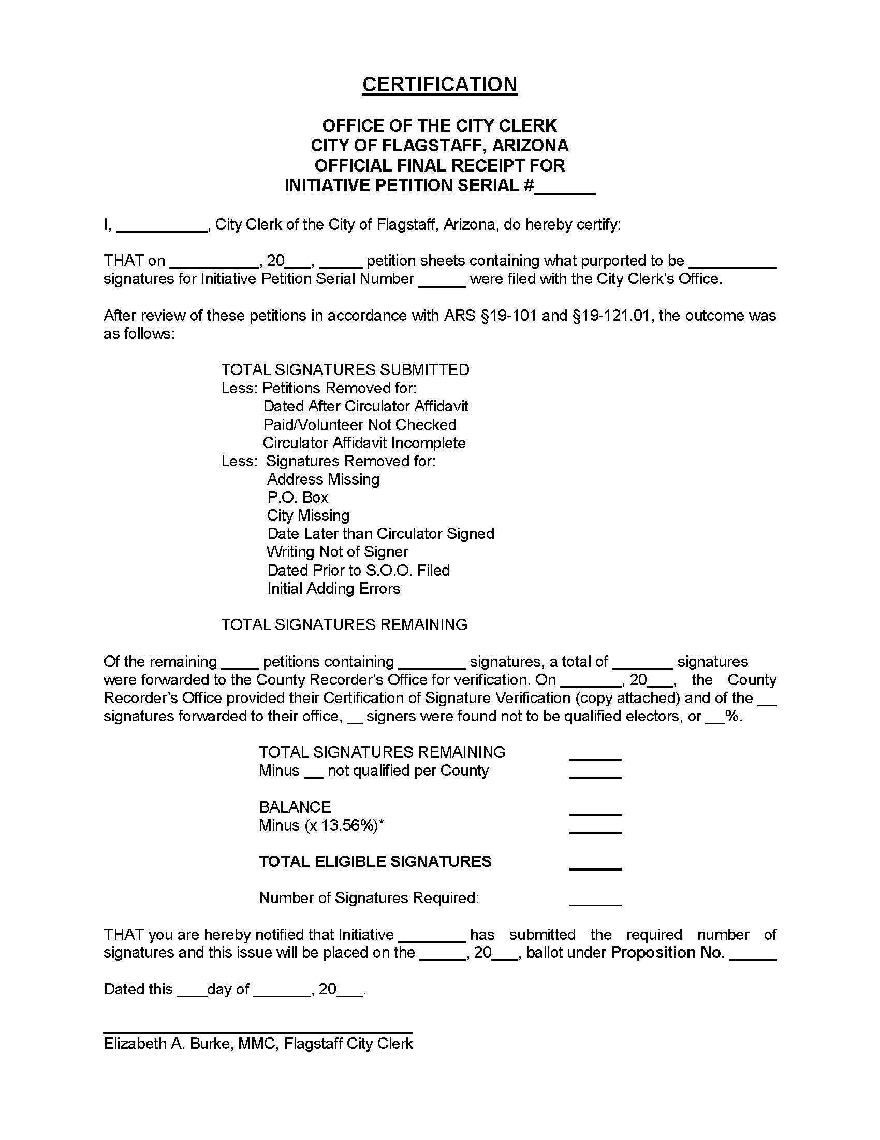
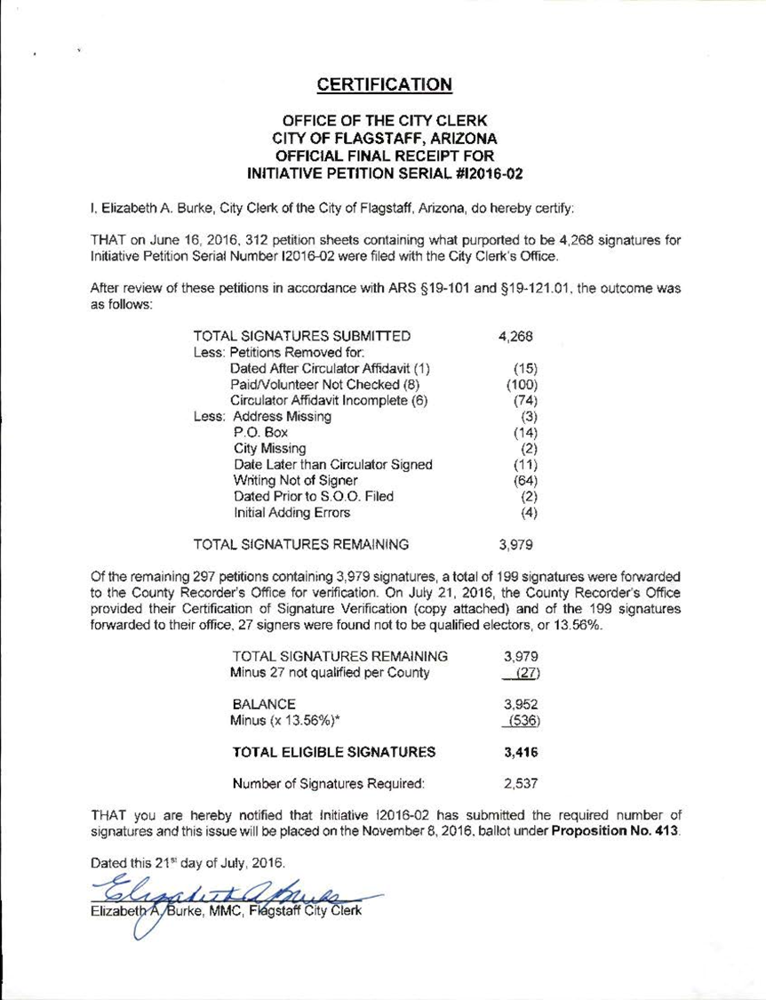
Notes:
SS
This is the final receipt issued in Flagstaff. Again, we include the number of sheets removed and why, the number of signatures removed and why and then the results from the County. We then show the calculation of applying the random sample results to the total number of valid signatures.
Lastly we indicate whether or not the remaining signatures satisfy the requirements to be placed on the ballot.
The language in the receipt can be modified to address insufficient signatures as well.

Slide 32
FINAL thoughts…
2016 was the first year that I did initiatives and I did 3!
Sheet and Signature removal were the most nerve racking for me.
What if I missed one, what if I missed a lot?
There will be questions along the way.
Reach out to your fellow Clerks; there is so much experience and knowledge in this group.
Always include/consult your Attorney!!
Take your time and document everything!
Notes:
SS

Slide 33
QUESTIONS?

